Slide 1
7th International Conference on Trends in Electronics and Informatics (ICOEI 2023)
Segmentation based clustering of
Hyperspectral Images
Prashant Kumar Mali, Hitenkumar Motiyani, Quazi Sameed, Anand Mehta
Department of Civil Engineering, Institute of Infrastructure Technology,
Research and Management, Ahmedabad, India.
prashant.mali.19c@iitram.ac.in
hitenkumar.motiyani.19c@iitram.ac.in
sameed.quazi.19c@iitram.ac.in
anandmehta@iitram.ac.in
02

Slide 2
01 Introduction
02 Objective
03 Literature Review
04 Dataset
05 Methodology
06 Results and Discussion
07 Summary
08 References
TABLE OF CONTENTS
02

Slide 3
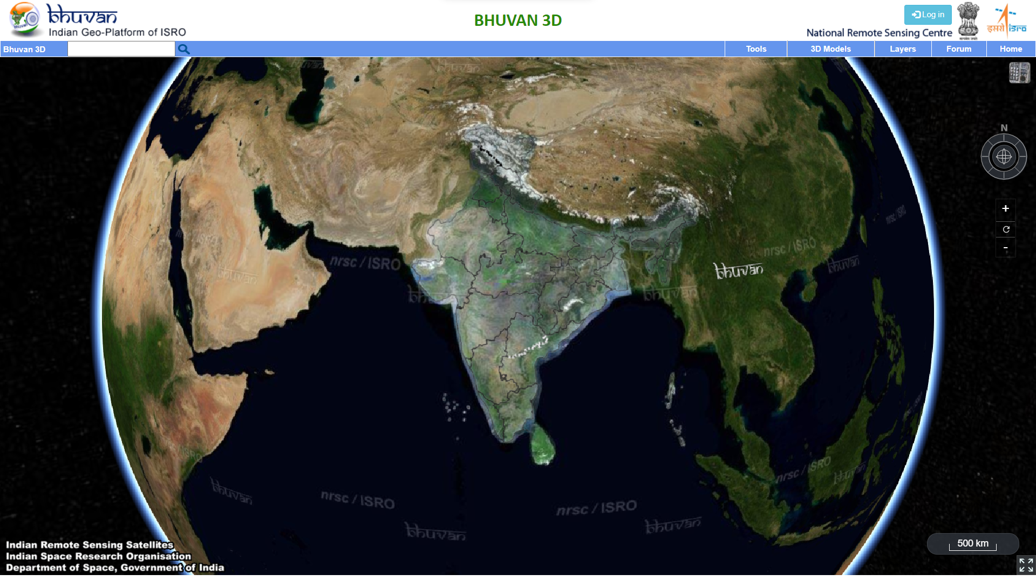
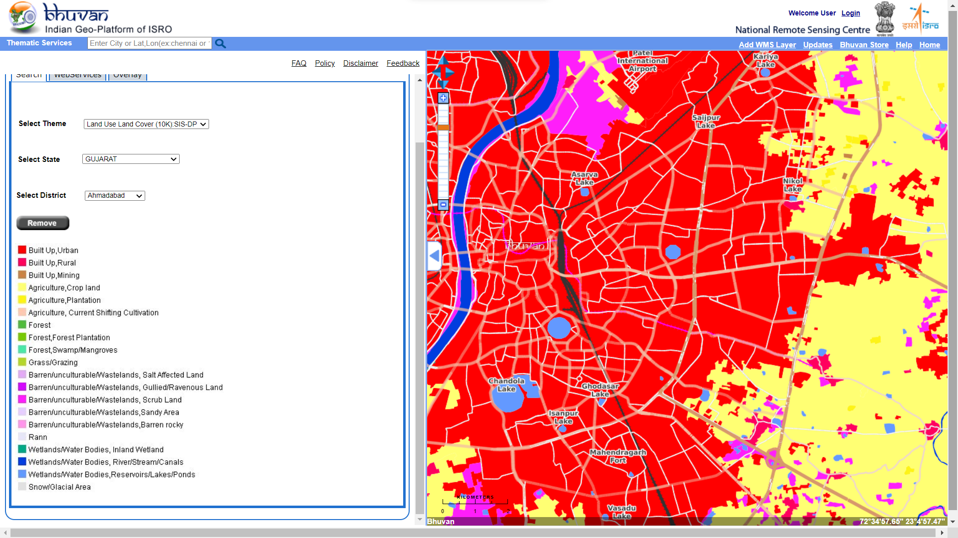
Introduction
Remote sensing refers to obtaining information about an object, area, or phenomenon through the analysis of data acquired by a device that is not in contact with the object, area, or phenomenon under investigation.
Remote sensing systems are a very important source of information for GIS, as they provide access to spatio-temporal information on surface processes on scales ranging from regional to global.
The spatial data generally is in the form of maps, which could be showing topography, geology, soil types, forest and vegetation, land use, water resource availability etc., stored as layers in a digital form.
Integrating many layers of data in a computer can easily generate new thematic maps.
Bhuvan, is an Indian web based utility provides a set of map based content prepared by ISRO
Land Use Land Cover data of the Ahmedabad city
03

Slide 4
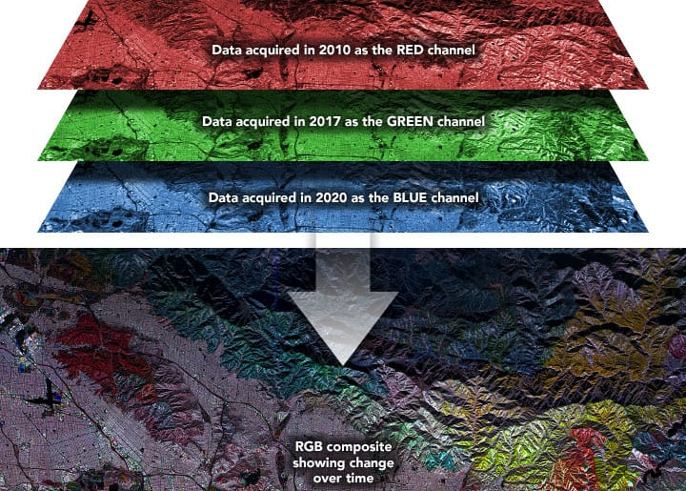
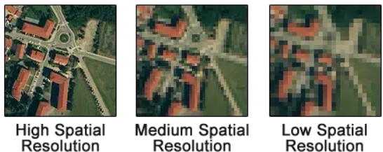
Digital Image
An image is represented by its dimensions (height and width) based on the number of pixels. This pixel is a point on the image that takes on a specific shade, opacity or color. It usually represented in Grayscale, RGB.
Digital Image may consists of
Spatial component describes the quality of an image and how detailed objects are in an image. If the grid cells are smaller, this means the spatial resolution has more detail with more pixels.
Spectral Component describes the amount of spectral detail in a band. High spectral resolution means its bands are more narrow.
Radiometric Component corresponds to the sensitivity of a sensor, i.e. its ability to measure and to enable distinction within the same spectral band of differences in the electromagnetic energy reflected by the elementary ground surfaces.
Temporal Component corresponds a series of images taken at different time to monitor the dynamic changes of the objects
Temporal data showing wildfire in 2010, 2017, and 2020.
04

Slide 5
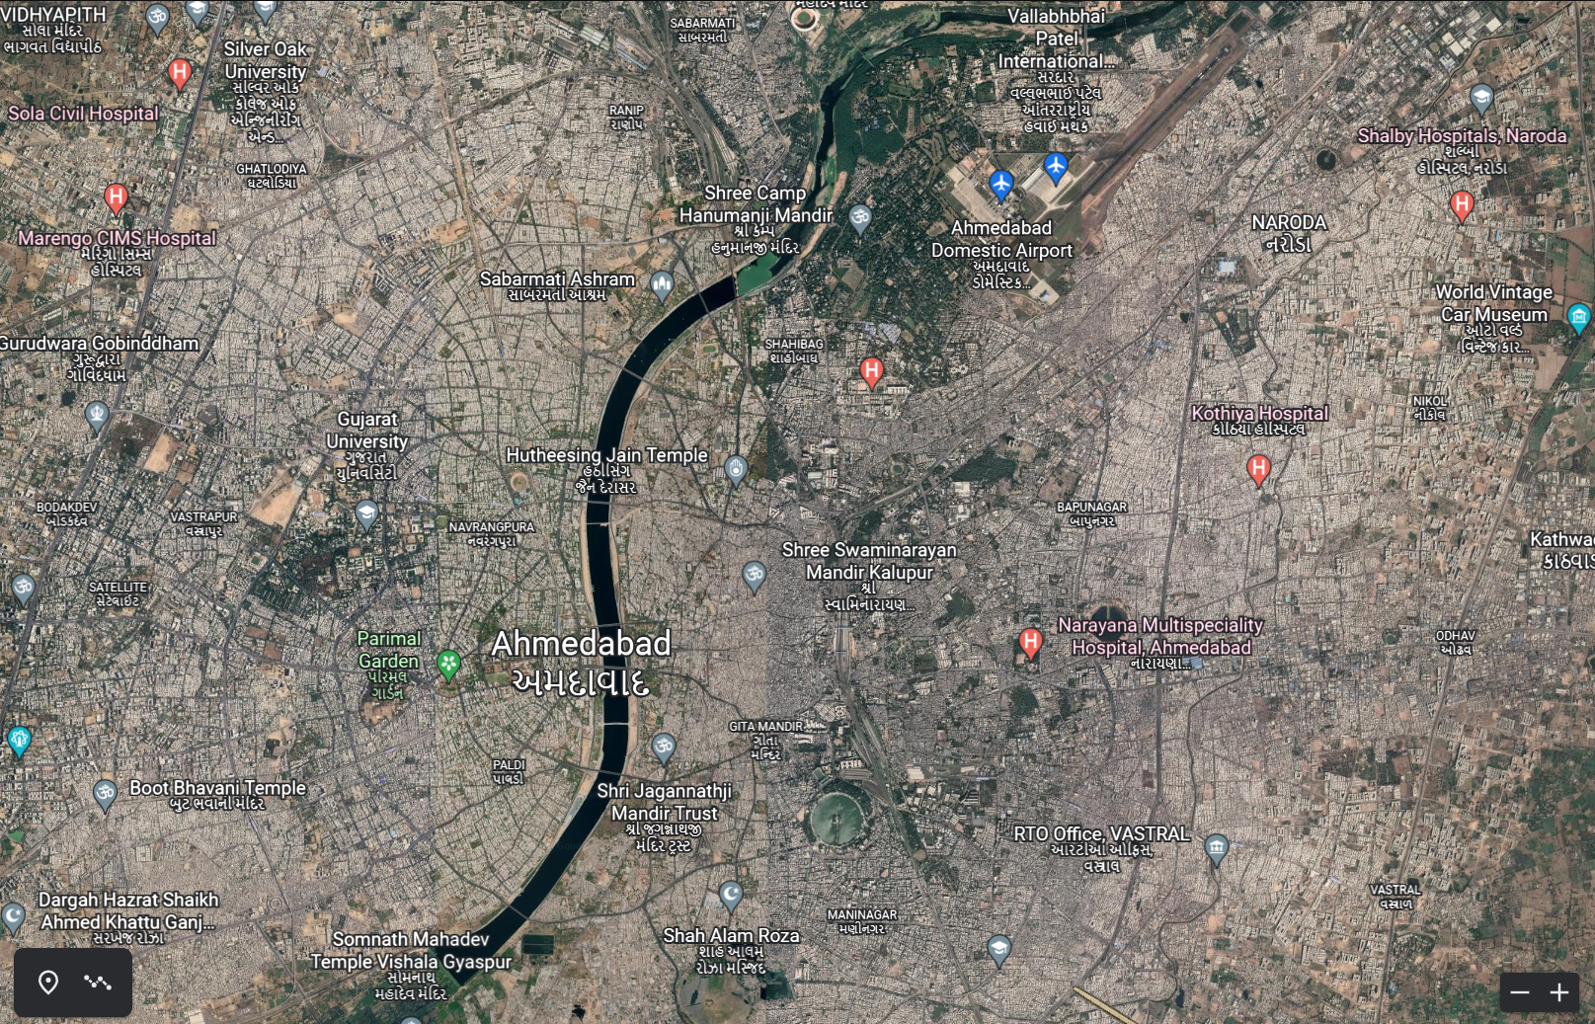
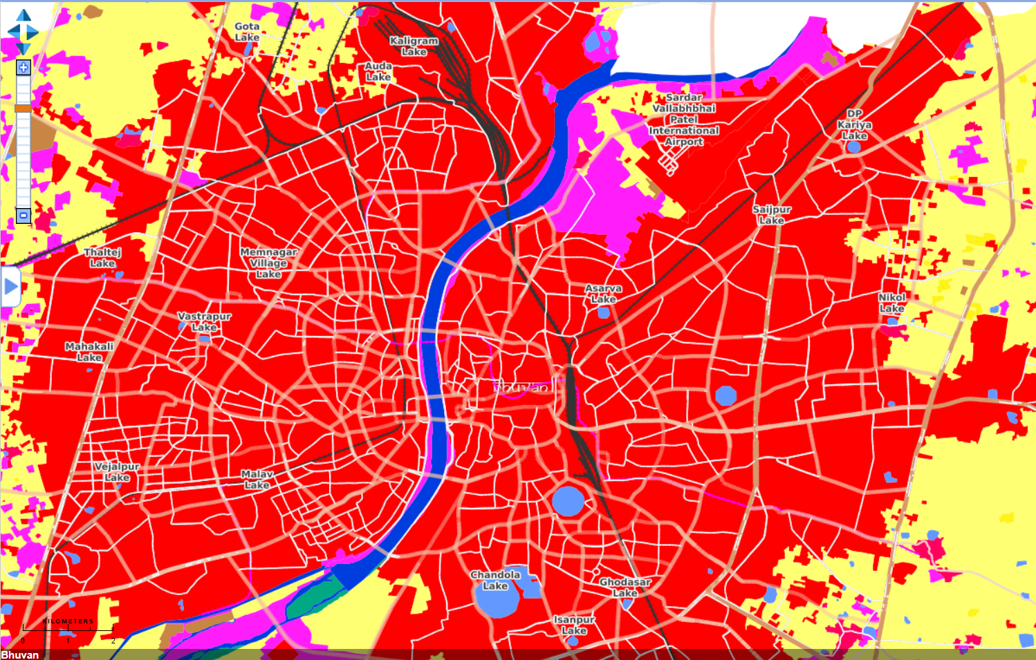
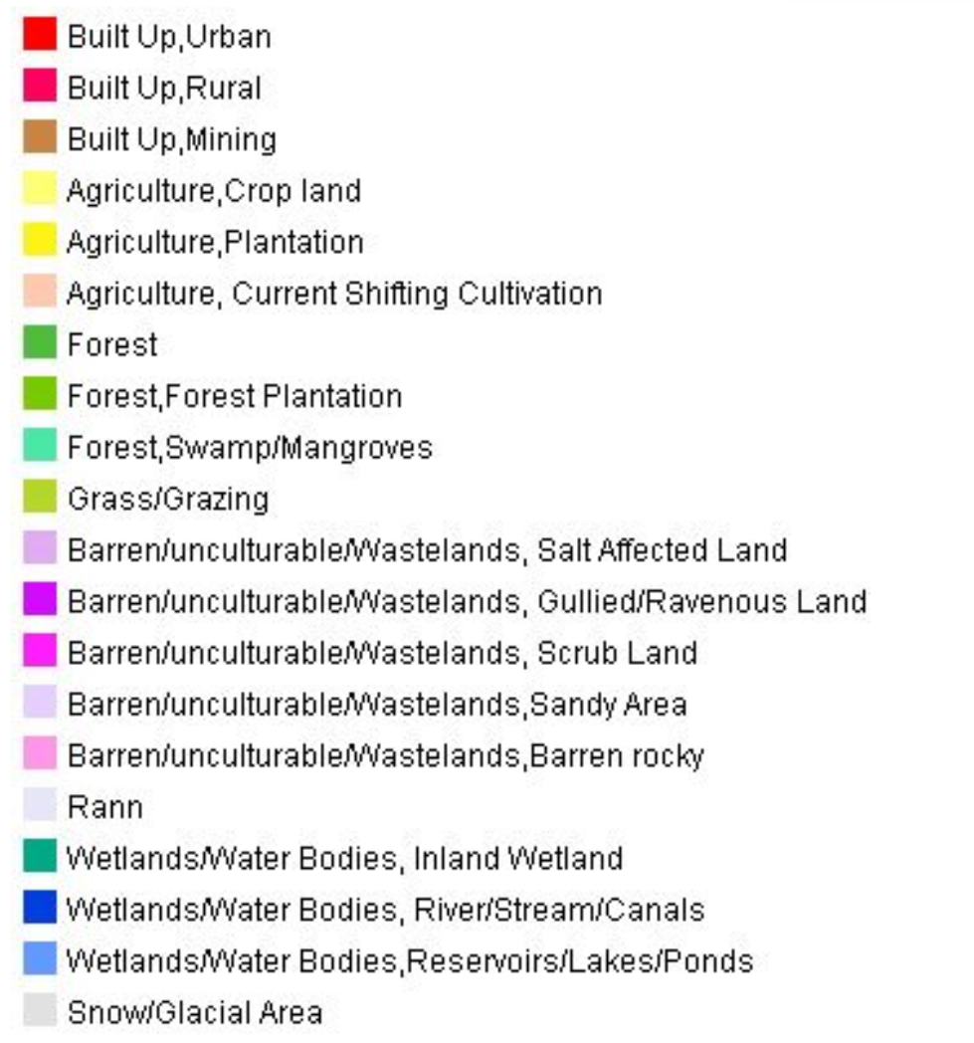
Information Conversion
Classification
Unclassified image of Ahmedabad City downloaded from Google Earth
Classified LULC data of Ahmedabad City downloaded from Bhuvan NRSC
Need of Land Use Land Cover Data:
Provides a better understanding of land utilization aspects,
Land cover and use information may be used for planning, monitoring, and evaluation of development, industrial activity, or reclamation.
05

Slide 6
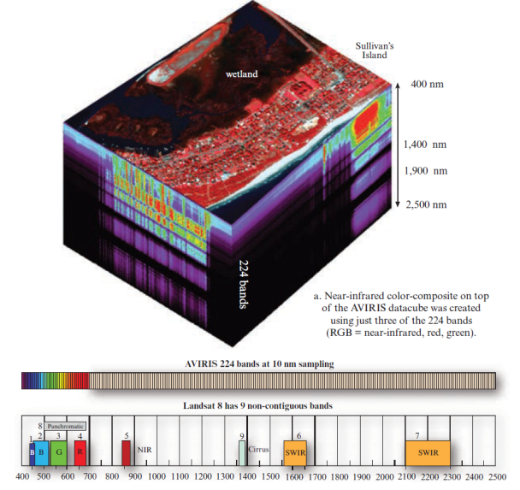
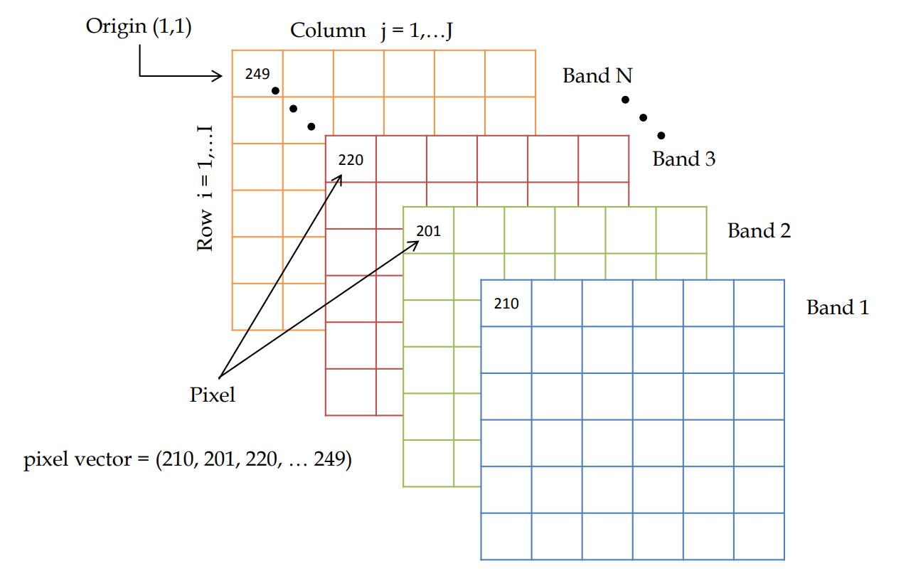
Objective
To propose a novel segmentation-based clustering methodology for classification of hyperspectral image. To improve classification accuracy of the input dataset.
Hyperspectral image is considered in the form of a matrix which comprises information in rows and columns with number of pixels and bands.
Bands are continuous and regularly spaced.
Higher spectral resolution, thus giving the opportunity to push further the information extraction capability
Source: Remote Sensing of the Environment – An Earth Resource Perspective, by John R. Jensen
06

Slide 7
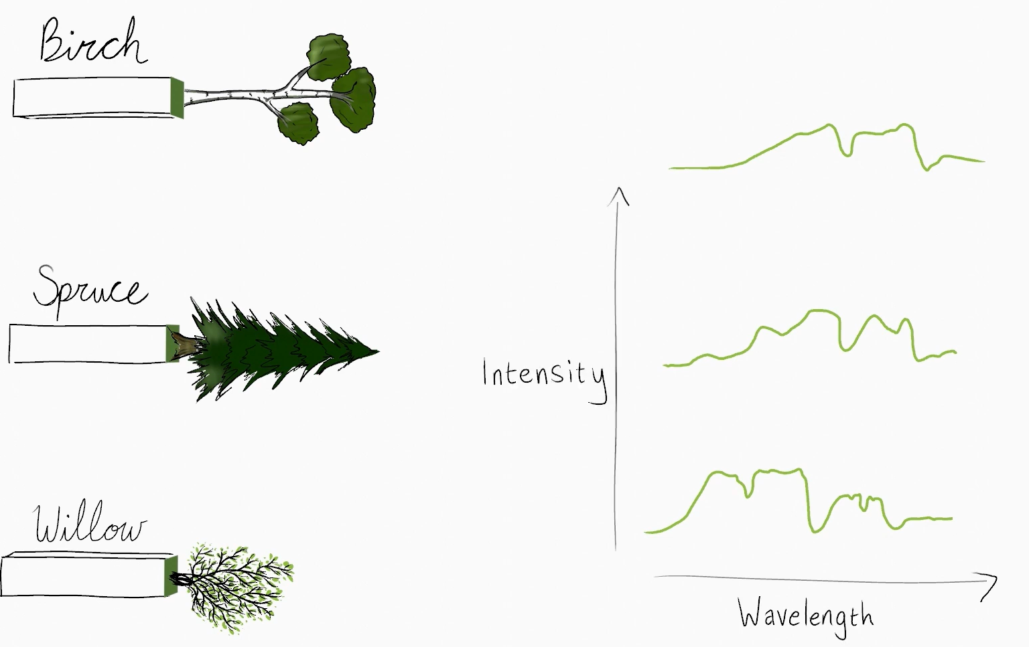

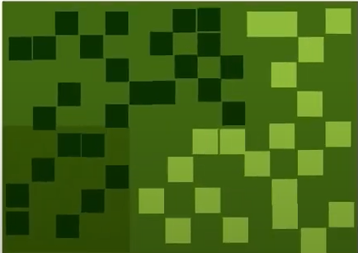
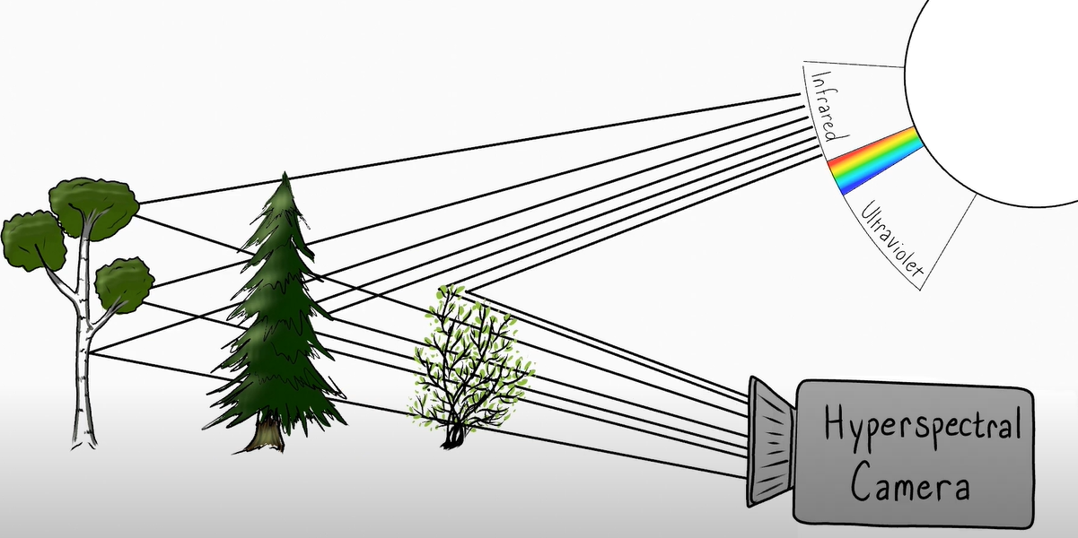
Source: https://youtu.be/0gs-Ohg8KIM
07

Slide 8
Literature Review
Sr No. | Year of Publication | Paper/Book | Remarks
1 | August, 2022 | Yao Ding; Zhili Zhang; Xiaofeng Zhao; Yaoming Cai; Siye Li; Biao Deng; Weiwei Cai, "Self-Supervised Locality Preserving Low-Pass Graph Convolutional Embedding for Large-Scale Hyperspectral Image Clustering“, IEEE Transactions on Geoscience and Remote Sensing. | Compared with supervised or semi-supervised methods, HSI clustering is often a fundamental but challenging task, due to prior knowledge deficiency, large spectral variability, and high dimension of HSI.
2 | February, 2022 | Sen Jia; Yue Yuan; Nanying Li; Jianhui Liao; Qiang Huang; Xiuping Jia; Meng Xu, "A Multiscale Superpixel-Level Group Clustering Framework for Hyperspectral Band Selection", IEEE Transactions on Geoscience and Remote Sensing. | Principal Component Analysis (PCA) was introduced as a linear dimensionality reduction technique for HSI which projects the high-dimensional data to a low-dimensional subspace with principal components maximizing the variance of the projected data.
3 | April, 2020 | J. Chang, G. Meng, L. Wang, S. Xiang and C. Pan, "Deep self-evolution clustering", IEEE Trans. Pattern Anal. Mach. Intel. | The key to the HSI clustering is to measure the similarity between data points.
4 | July, 2017 | Y. Li, L. Zhang, C. Tian, C. Ding, Y. Zhang and W. Wei, "Hyperspectral image super-resolution extending: An effective fusion based method without knowing the spatial transformation matrix", Proc. IEEE Int. Conf. Multimedia Expo (ICME) | The abundant spectral information of HSIs comes at the cost of greatly reducing spatial resolution which hinders the widespread applications of HSIs.
08

Slide 9
Literature Review
Sr No. | Year of Publication | Paper/Book | Remarks
5 | January, 2013 | B. Luo, C. Yang, J. Chanussot and L. Zhang, "Crop yield estimation based on unsupervised linear unmixing of multidate hyperspectral imagery", IEEE Trans. Geosci. Remote Sens. | HSIs can provide rich band information from different wavelengths and thus get widely used in various research field, such as biological analysis.
6 | October, 2011 | J. Khodr and R. Younes, "Dimensionality reduction on hyperspectral images: A comparative review based on artificial datas“. | Moreover, due to the high correlation among the neighboring bands, which not only increases the computational complexity of the classifiers but also may have a negative impact on the classification accuracy, dimensionality reduction (DR) should be applied as a preprocessing step to discard the redundant information.
7 | December, 2007 | A. Martínez-usó, F. Pla, J. M. Sotoca and P. García-sevilla, "Clustering-based hyperspectral band selection using information measures", IEEE Trans. Geosci. Remote Sens. | The importance of a band obtained by unsupervised methods is evaluated by various statistical measures or clustering quality assessment which is unrelated to the labeled sample size.
09

Slide 10
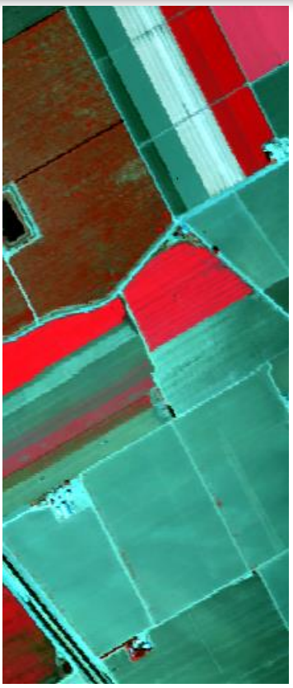

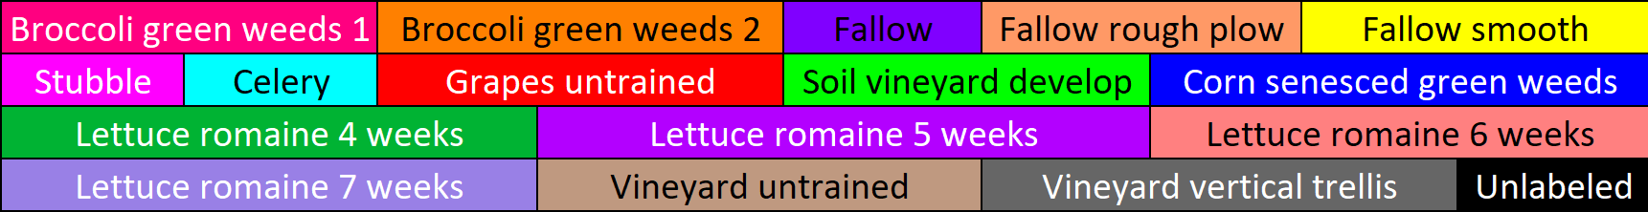
Dataset
The experiments were conducted over three sets of hyperspectral images respectively are Salinas, Pavia centre and Pavia University.
Salinas scene was collected by the 224-band AVIRIS sensor over Salinas Valley, California, and is characterized by high spatial resolution (3.7-meter pixels). The area covered comprises 512 lines by 217 samples. This image was available only as at-sensor radiance data. It includes vegetables, bare soils, and vineyard fields. Salinas ground truth contains 16 classes.
Source: Salinas Dataset, 2021: www.ehu.eus/Hyperspectral_Remote_Sensing_Scenes
Salinas and Ground Truth
10

Slide 11
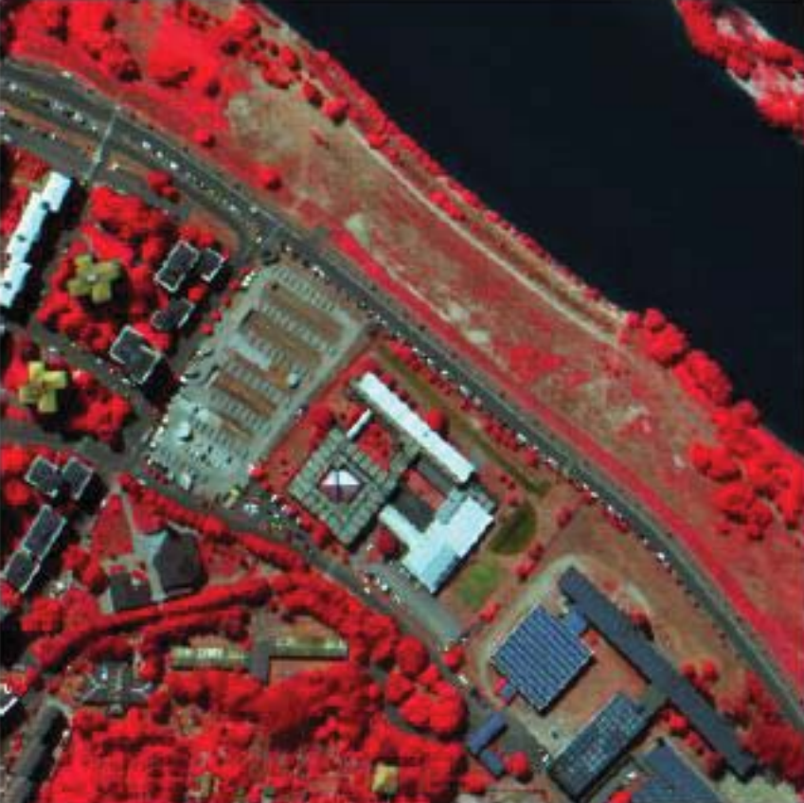
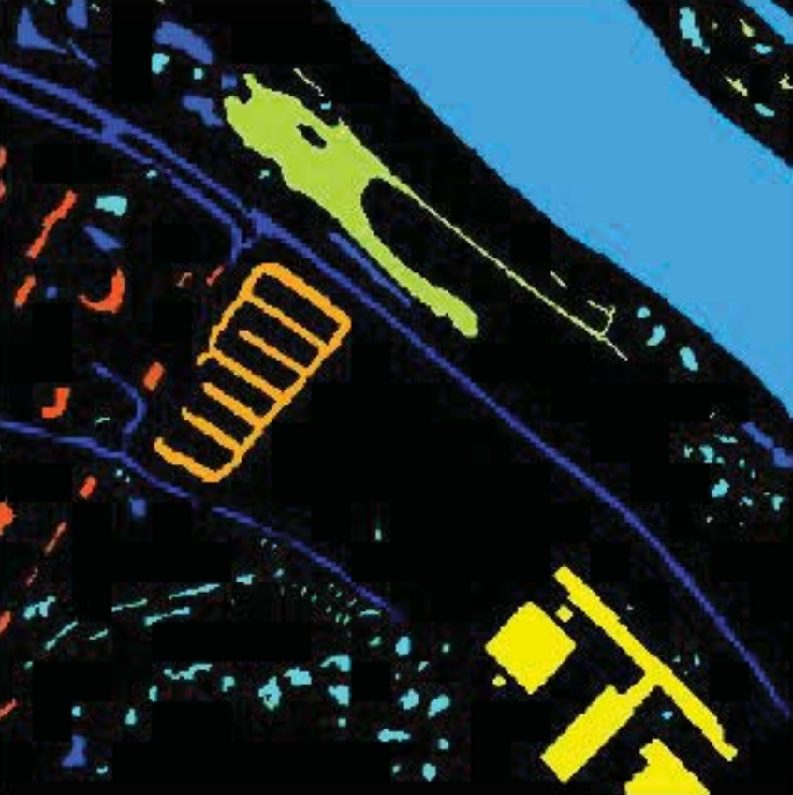
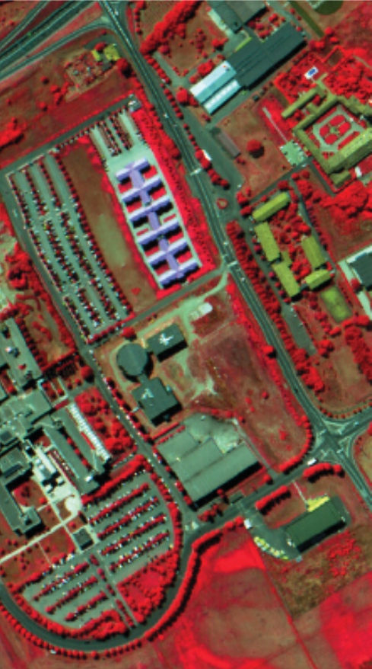
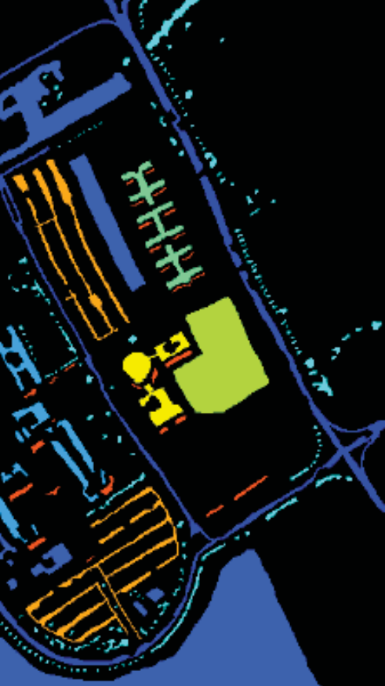
Dataset
The experiments were conducted over three sets of hyperspectral images respectively are Salinas, Pavia centre and Pavia University.
Pavia Centre and Pavia University are two scenes acquired by the ROSIS sensor during a flight campaign over Pavia, northern Italy. The number of spectral bands is 102 for Pavia Centre and 103 for Pavia University. Pavia Centre is a 400 × 400 pixels image, and Pavia University is 610 × 340 pixels. The geometric resolution is 1.3 meters. Pavia centre ground truth contains 8 classes while Pavia university ground truth contains 9 classes.
Pavia Centre and Ground Truth
Pavia University and Ground Truth
Source: Pavia University and Pavia center datasets 2021. www.ehu.eus/ccwintco/index.php/Hyperspectral_Remote_Sensing_Scenes
11

Slide 12
Methodology
12

Slide 13
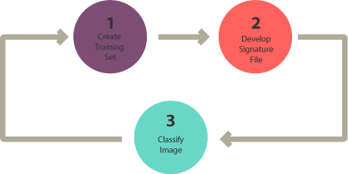
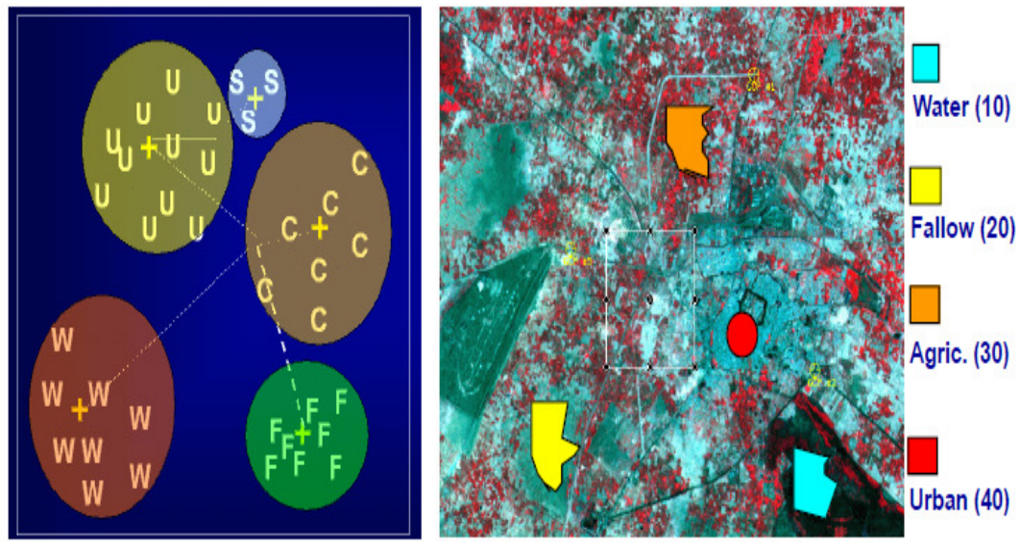
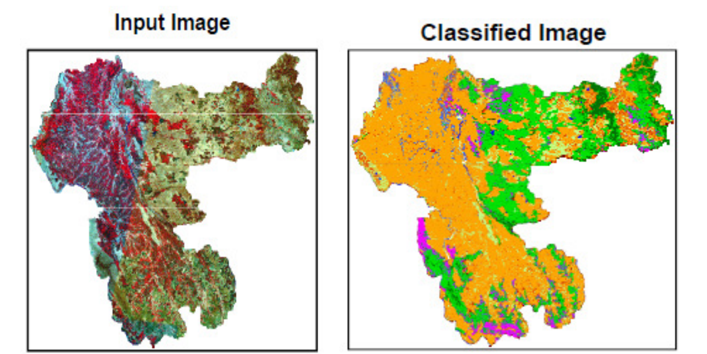
Image Classification
Image classification is the process of categorizing and labeling groups of pixels or vectors within an image based on specific rules. The categorization law can be devised using one or more spectral or textural characteristics.
Each pixel of the image is assigned to a particular class.
Classification transforms the image data into an information
1. Supervised Classification
Identify training set (information class),
Select sample pixels in an image representing specific class,
Direct the image processing software to use training sets as references for the classification of all other pixels in the image.
Training Sets
Image Classification
Source: https://gisgeography.com/supervised-unsupervised-classification-arcgis/
13

Slide 14
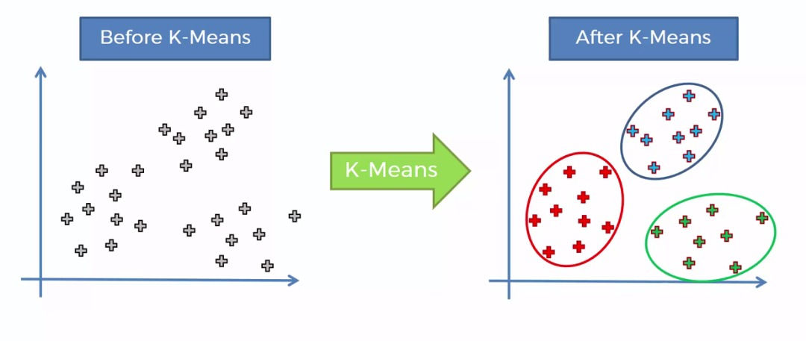
2. Unsupervised classification
Unsupervised classification requires no advance information about the classes of interest. Rather, it examines the data and breaks it into the most prevalent natural spectral groupings, or clusters, present in the data.
k-means clustering
k-means is a commonly used partitioning based clustering technique that tries to find a user specified number of clusters (k), which are represented by their centroids, by minimizing the square error function. Although k-means is simple and can be used for a wide variety of data types.
The steps of the k-means algorithm are written below:
Initialization: choose randomly k pixel vectors (data points) to initialize the clusters.
Nearest-neighbor search: for each input vector, find the cluster center that is closest, and assign that input vector to the corresponding cluster.
Mean update: update the cluster centers in each cluster using the mean (centroid) of the input vectors assigned to that cluster.
k-means clustering algorithm
14

Slide 15
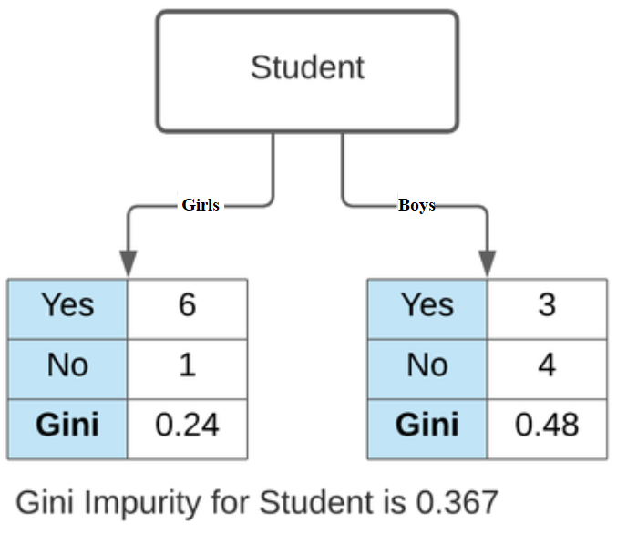
Gini Impurity
Gini Impurity measures the probability for a random instance being misclassified when chosen randomly. The lower the Gini Impurity, the lower the likelihood of misclassification.
Consider a dataset D that contains samples from k classes. The probability of samples belonging to class i at a given node can be denoted as pi. Then the Gini Impurity of is defined as:
Source: https://www.learndatasci.com/glossary/gini-impurity/
15

Slide 16
Proposed Methodology
k-means
Gini Impurity
Hyperspectral Image
Image Segmentation
Local Band Selection
Clustering
Accuracy Assessment
16

Slide 17
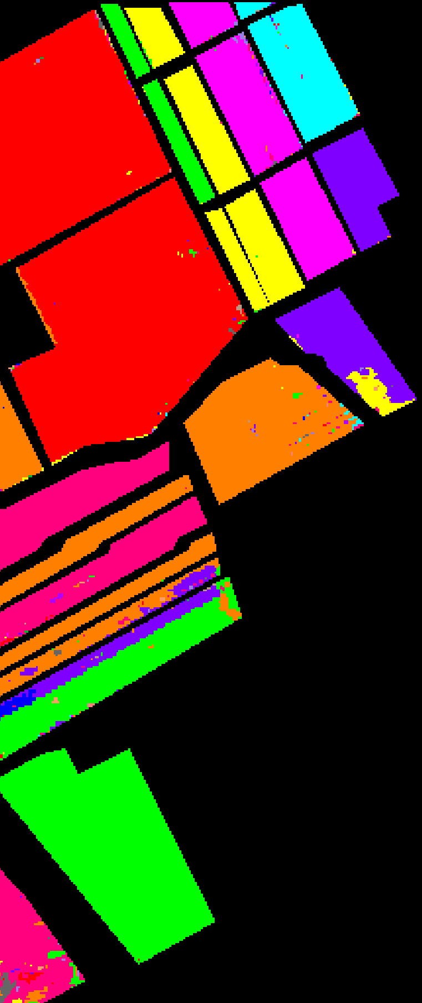
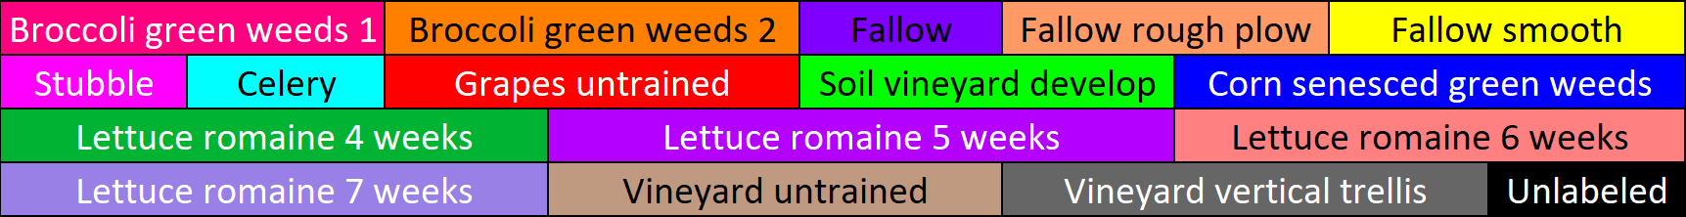
NMI and Purity
Purity is a measure of the extent to which clusters contain a single class.
Mutual Information is a function that measures the agreement of the two assignments.
Classified Reference
http://nlp.stanford.edu/IR-book/html/htmledition/evaluation-of-clustering-1.html
Cai, D., X. He, and J. Han. 2005. “Document Clustering Using Locality Preserving Indexing.” IEEE Transactions on Knowledge and Data Engineering, 17 (12): 1624-1637.
17

Slide 18
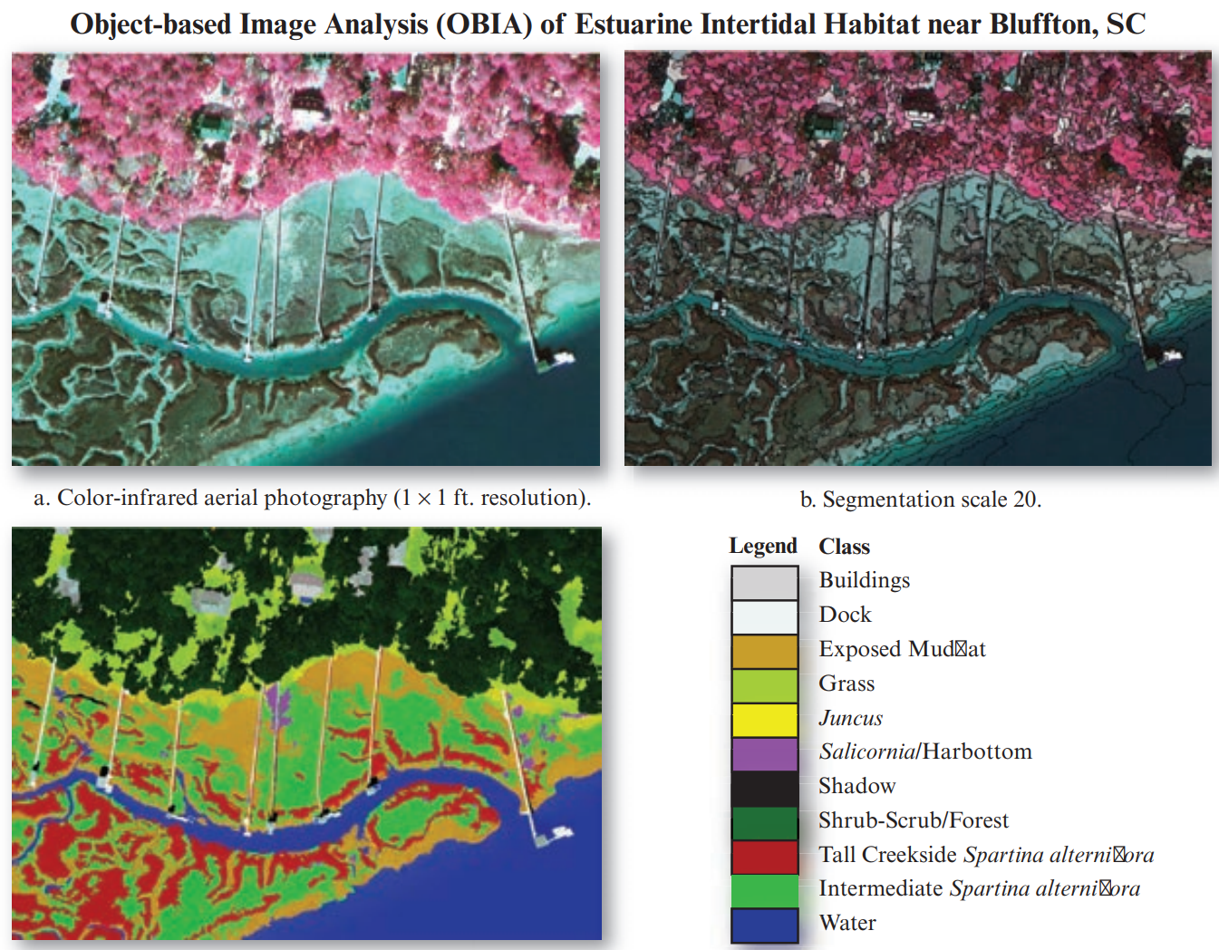
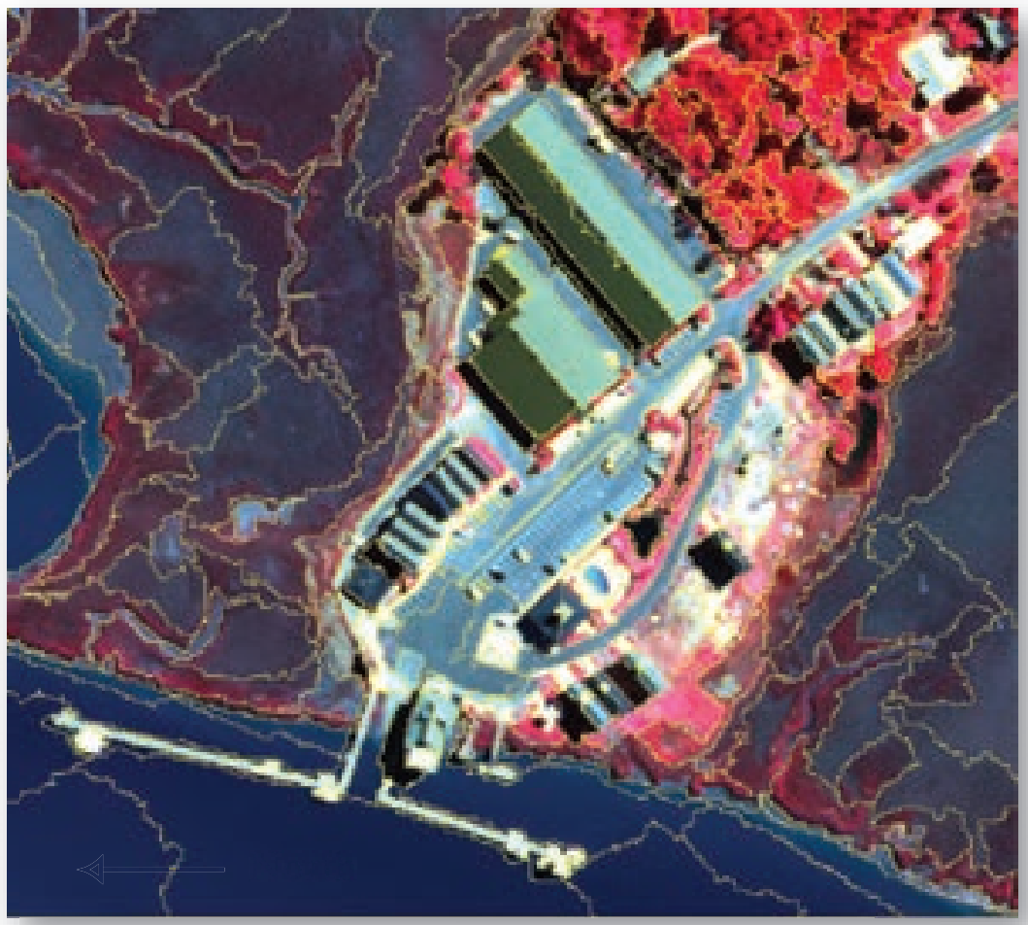
Image Segmentation
Image segmentation is the process of assigning a label to every pixel in an image such that pixels with the same label share certain characteristics. The result of image segmentation is a set of segments that collectively cover the entire image, or a set of contours extracted from the image.
Each of the pixels in a region is similar with respect to some characteristic or computed property, such as color, intensity, or texture.
John R. Jensen. 2016.Introductory digital image processing: A remote sensing perspective. Pearson, 4th edition.
18

Slide 19
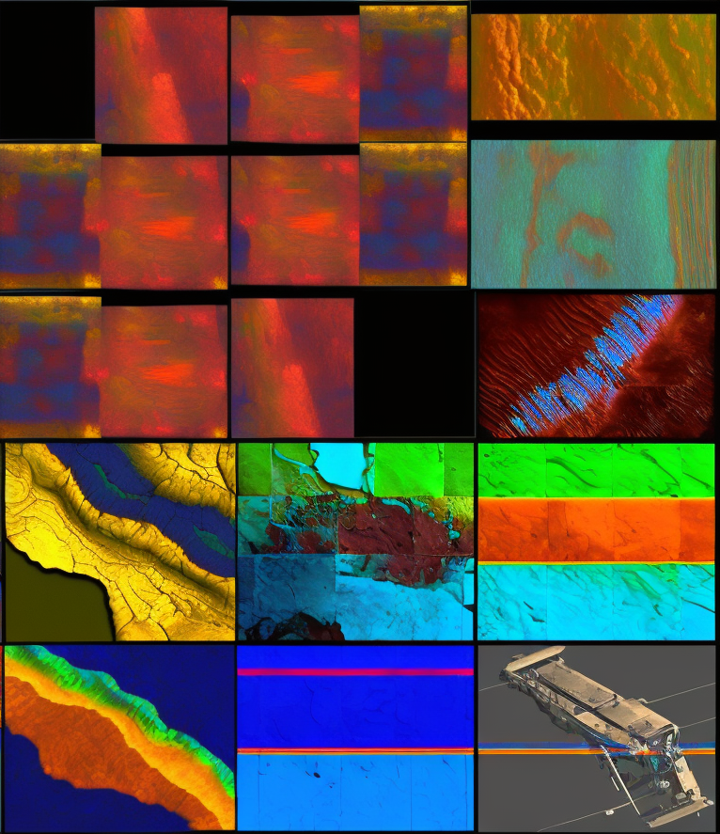
Local Band
Selection
19

Slide 20
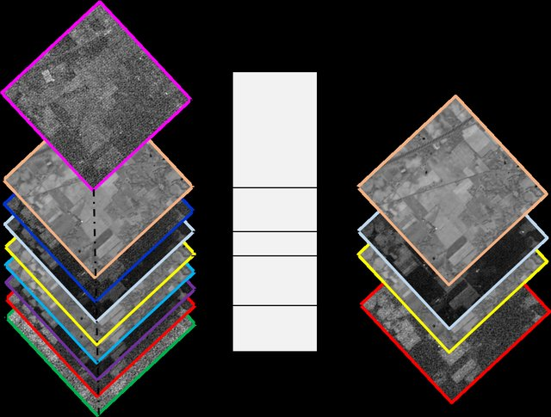
Local Band Selection
A hyperspectral image has a very high spectral resolution due to the number of pixels and bands it contains. As
a result, it’s important to arrange number of bands in a dataset without drastically reducing the amount of information
maintained.
It is necessary to perform band selection method as:
These bands make training extremely slow.
Harder to find a good solution.
Steps for selecting top-ranked bands:
Gini impurity is used as a ranking criteria to select the top-ranked bands in a sorted sequence containing relevancy and less redundancy.
A distance-weighted parameter called score is introduced to prevent bands with same gini indices.
Band Selection Technique
Source: https://www.researchgate.net/profile/PedramGhamisi/publication/322281687/figure/fig1/AS:580431734743040@1515397117915/Hyperspectral-image-dimensionality-reduction_W640.jpg
20

Slide 21
Local Band Selection
To calculate score, delta function is used that stores maximum distance for a test band from all bands whose gini index is higher than that of test band.
Formally, score is formulated in equation as :
where,
d is distance between mean vectors of all pixels in a cluster for particular segment to remaining bands of the segment,
GI is the gini index for corresponding bands,
i and j are band indexes.
21

Slide 22
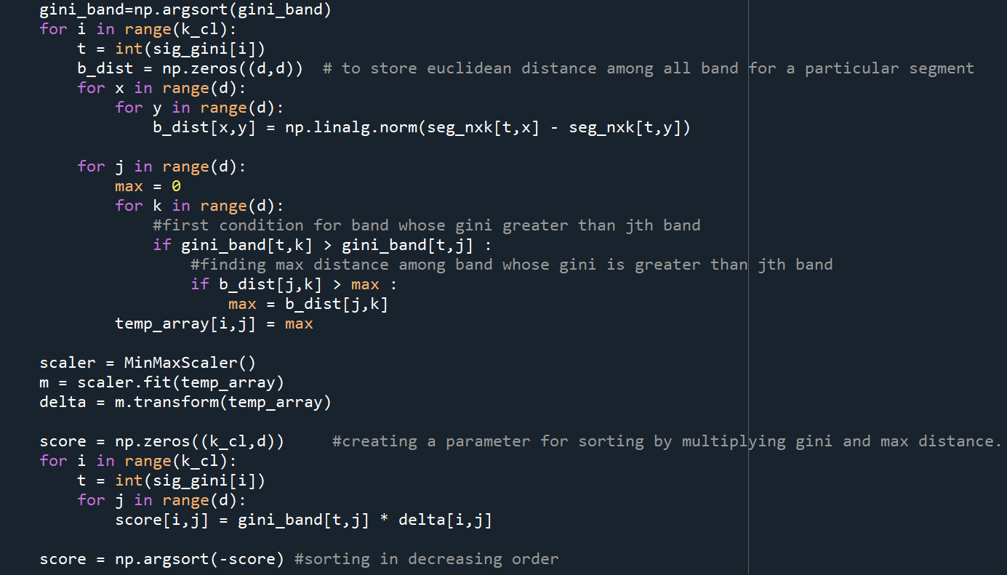
Calculation of delta function, that stores maximum distance for a test band from all bands whose gini index is higher than that of test band.
Calculation of score, that stores delta × Gini Index for each band.
22

Slide 23
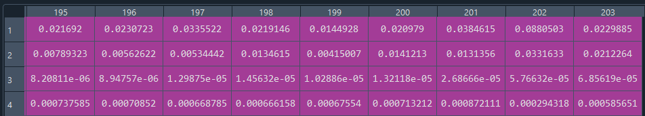
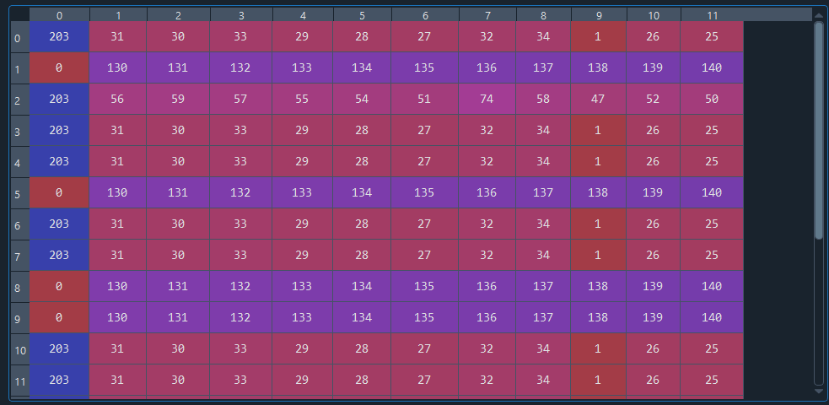
Bands and their Ginni index →
Top 12 Significant Bands (L = 12) →
Top 16 Significant Segments (k_cl = 16) →
23

Slide 24

Segmentation
24

Slide 25
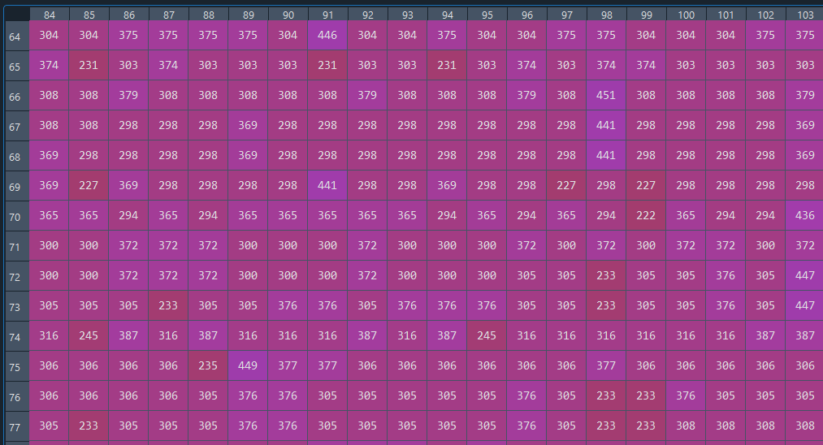
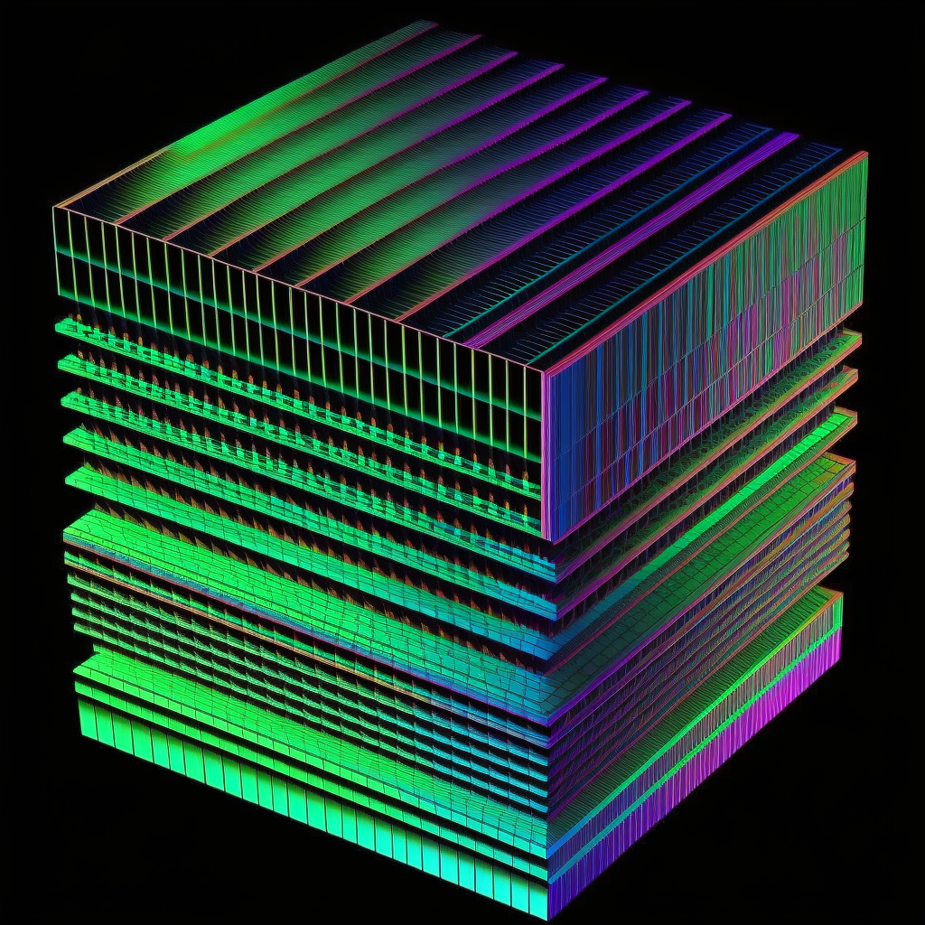
A small part of Input image (512 x 217)
25

Slide 26
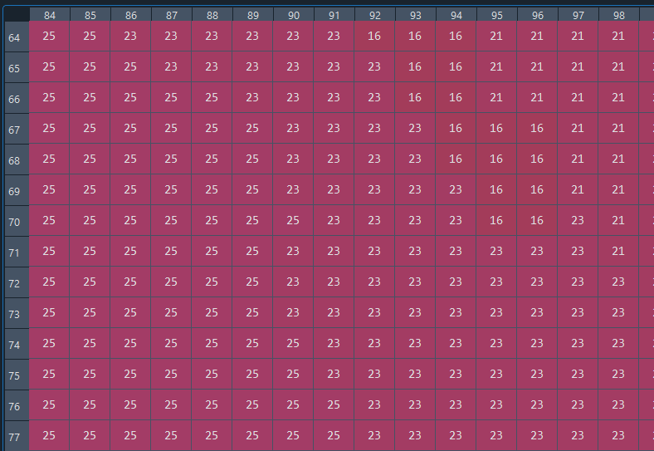
A part of segmented image (in matrix form of size 512 x 217)
Total 170 Segments
26

Slide 27

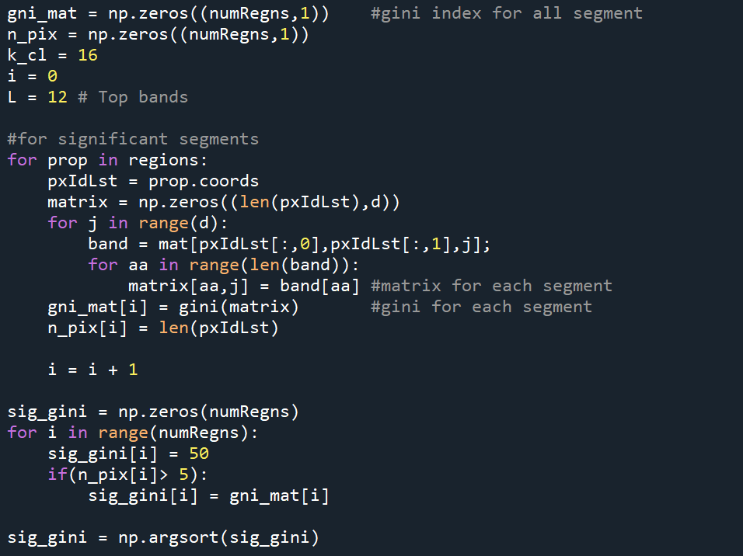
Calculation of Gini index for each segments.
Considering only those segments in which no. of pixels is greater than 5 and calculating Significant Segments on the basis of Gini Index and number of pixels.
27

Slide 28
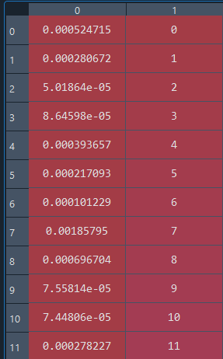
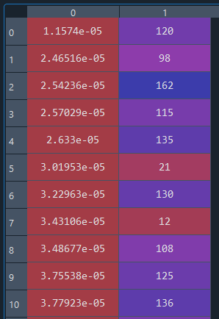
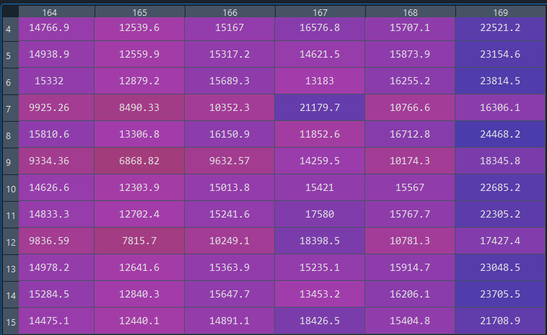
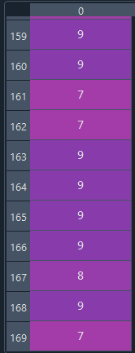
Segments are arranged (Ascending) based on their Ginni index
Labels are assigned to remaining segments according to minimum distance from best 16.
Pairwise distances of remaining segments from best 16 Segments.
Ginni No. of
Index Segments
Ginni No. of
Index Segments
Remaining Segments (16 to 169) →
Best 16 Segments
Best 16 out 170 segments are identified.
Labels (0 to 15) are given to remaining segments according to minimum distance from best 16.
28

Slide 29
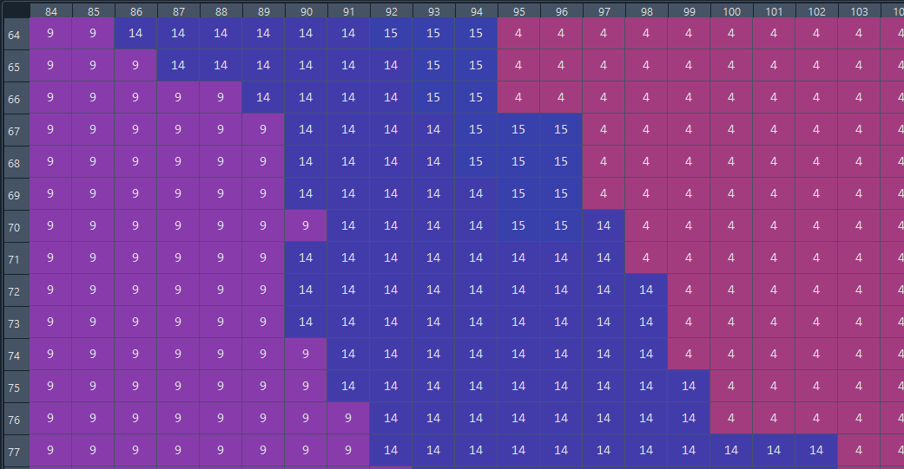
A small part of Relabelled Segmented image (512 x 217)
Total 16 Segments
29

Slide 30
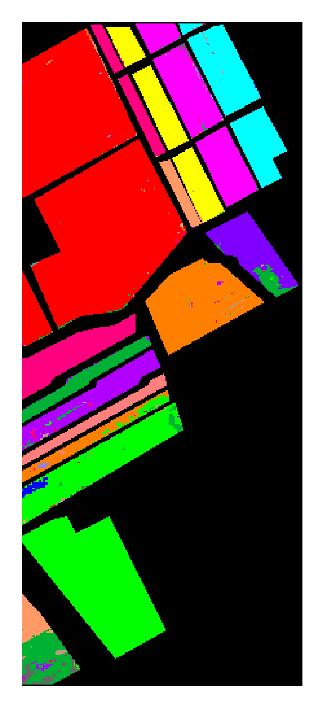
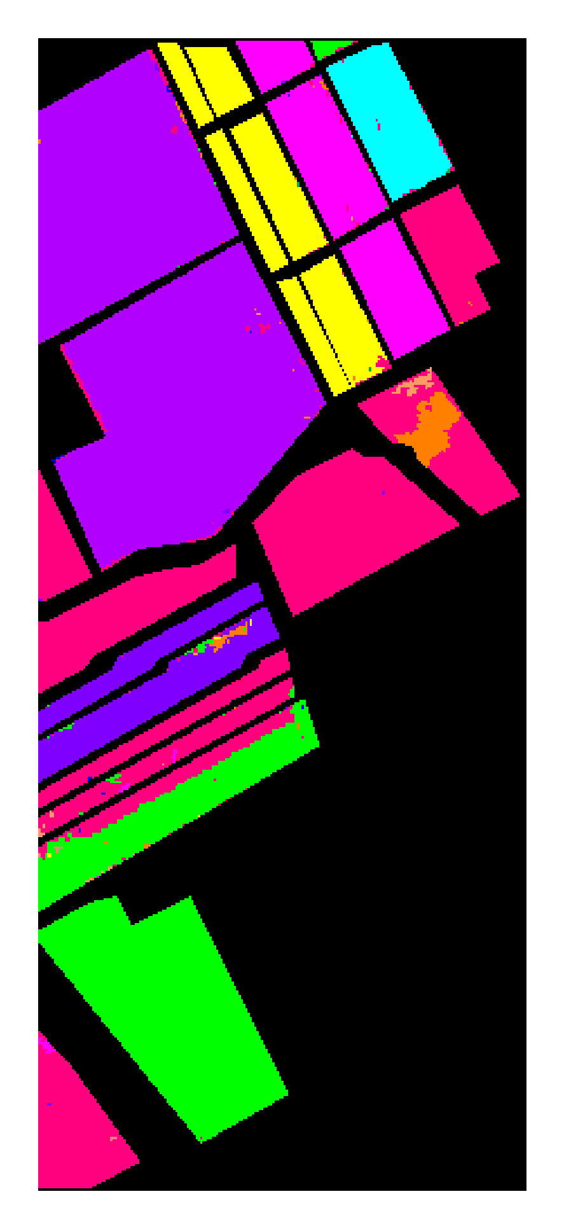
Results And Discussion
Salinas k_seg k_seg + LBS_{R} proposed Reference .
30

Slide 31
Results And Discussion
Datasets | Salinas
Methods | NMI | Purity
k-means | 0.7242 | 0.6734
k_seg | 0.7921 | 0.6738
k_seg + LBS_{R} | 0.7932 | 0.6426
proposed (k_seg+ LBS) | 0.8130 | 0.7011
Parameter Settings
Variables → | k_seg | k_cl | L
k-means | - | 16 | All bands
k_seg | 5 | 28 | All bands
k_seg + LBS_{R} | 7 | 18 | 12
proposed (k_seg+ LBS) | 6 | 26 | 12
k_seg is number of segments,
k_cl is number of significant clusters,
L is number of significant bands taken,
LBS_{R} is Local Band Selection with Redundant bands,
LBS is Local Band Selection without Redundancy.
← Methods
31

Slide 32
Results And Discussion
Followings are the acronyms for abovementioned methods:
SLIC is Simple Linear Iterative Clustering,
PCA is Principle Component Analysis,
H2NMF Hierarchical rank 2 non-negative matrix factorization,
LBS_{R} is Local Band Selection with Redundant bands,
LBS is Local Band Selection without Redundancy.
32

Slide 33
Summary
In this study several approaches of image classification based on segmentation clustering with local band selection techniques through gini impurity are preformed in order to enhance relevancy and remove redundancy.
Experiments were performed on Salinas, Pavia Center and Pavia University dataset and the results were compared on the basis of accuracy assessment.
Among the evaluated methods, higher accuracy is achieved by segments consisting less redundant bands.
The accuracy measurements in terms of NMI for k_seg + LBS for dataset Salinas is 0.8130 respectively.
33

Slide 34
Reference
[1] A. Femenias and S. Mar ́ın, “Hyperspectral imaging,” Electromagnetic Technologies in Food Science, 2021.
[2] M. Mateen, J. Wen, D. Nasrullah, and M. Azeem Akbar, “The role of hyperspectral imaging: A literature review,”
International Journal of Advanced Computer Science and Applications, vol. 9, p. 51, 09 2018.
[3] A. Mehta and O. Dikshit, “Comparative study on projected clustering methods for hyperspectral imagery classification,”
Geocarto International, vol. 31, pp. 296–307.
[4] A. F. Alkarkhi and W. A. Alqaraghuli, “Cluster analysis, chapter 11,” in Easy Statistics for Food Science with R, A. F.
Alkarkhi and W. A. Alqaraghuli, Eds. Academic Press, 2019, pp. 177–186.
[5] A. Mehta and O. Dikshit, “Projected clustering of hyperspectral imagery using region merging,” Remote Sensing Letters, vol.
7, no. 8, pp. 721–730, 2016.
[6] C. D. Manning, P. Raghavan, and H. Sch ̈utze, Introduction to Information Retrieval. Cambridge University
Press, 2008, cambridge Books Online. [Online]. Available: http://dx.doi.org/10.1017/CBO9780511809071
[7] A. Mehta and O. Dikshit, “Segmentation-based projected clustering of hyperspectral images using mutual nearest neighbour,”
IEEE Journal of Selected Topics in Applied Earth Observations and Remote Sensing, vol. 10, no. 12, pp. 5237–5244, 2017.
[8] Y. Li and H. Wu, “A clustering method based on k-means algorithm,” Physics Procedia, vol. 25, pp. 1104–1109, 12 2012.
[9] S. Lloyd, “Least squares quantization in pcm,” IEEE Transactions on Information Theory, vol. 28, pp. 1104–1109, 1982.
[10] A. K. Jain, M. N. Murty, and P. J. Flynn., Data Clustering: A Review, 1999, pp. 264–323.
[11] J. A. Richards, Remote Sensing Digital Image Analysis: An Introduction Springer-Verlag, Berlin, Heidelberg, 5th Edition,
2013, pp. 403–446.
[12] Ehu, “Salinas, pavia university and pavia center datasets,” Accessed on 2021. [Online]. Available:
https://www.ehu.eus/ccwintco/index.php?title=Hyperspectral_Remote_Sensing_Scenes
34

Slide 35

THANK YOU
35

